Slide 1

IPL Power BI EDA
By
Neelanjan Chakraborty

Slide 2
Contents
Business Objective – Problem Statement
Solution Methodology
Data Preparation and Consolidation
Key Challenges
Result
Conclusion

Slide 3
Business Objective – Problem Statement
Identifying the team that has more chance to win the upcoming seasons by finding observations like success rate of each team, identify the team that has won maximum seasons, best defending and chasing team and analyze the toss decisions etc.
Problem Statements
To find the team that won the most number of matches in a season.
To find the most winning team for each season.
Does winning toss increases the chances of victory.
To find the stadium with the maximum number of IPL matches.
Objectives

Slide 4
Solution Methodology
Solution Methodology
Technology Enablers
Realized Objectives
DATA CLEANING
To get the probability of winning the match
Can playing in home ground gives any advantage
ANALYSIS OF THE DATA
POWER BI
By winning the toss can increase the chance of winning the match
VISUALIZE THE DATA USING POWER BI
INTERPRETATION

Slide 5
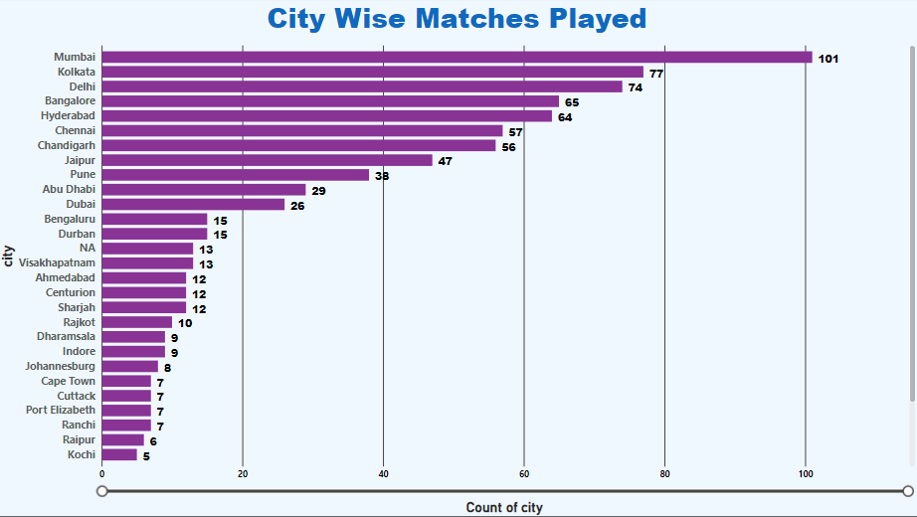
Data Preparation and Consolidation

Slide 6
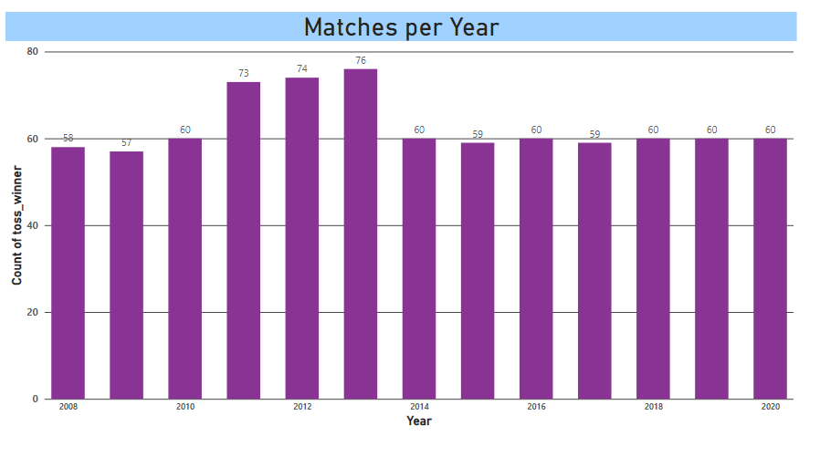
Data Preparation and Consolidation

Slide 7
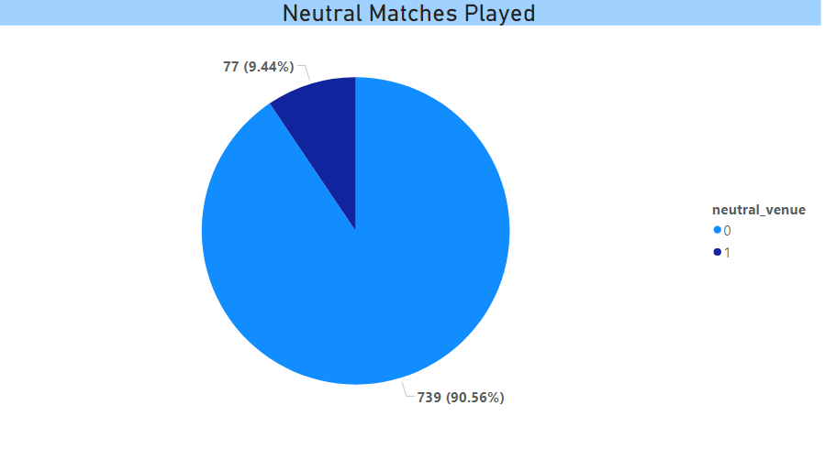
Data Preparation and Consolidation

Slide 8
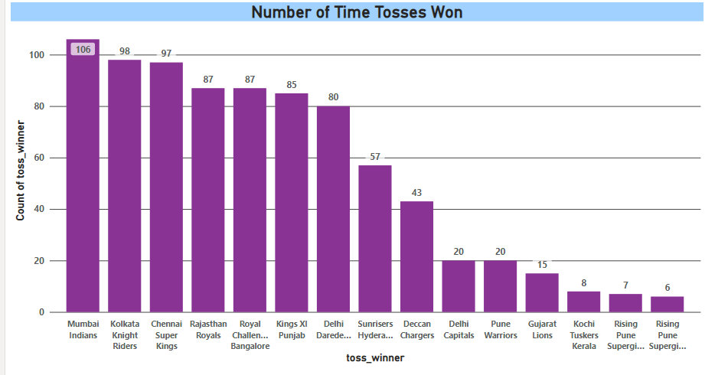
Data Preparation and Consolidation

Slide 9
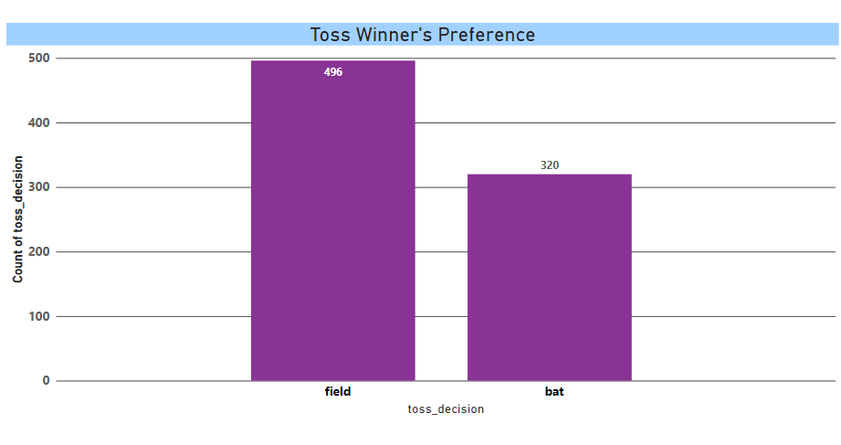
Data Preparation and Consolidation

Slide 10
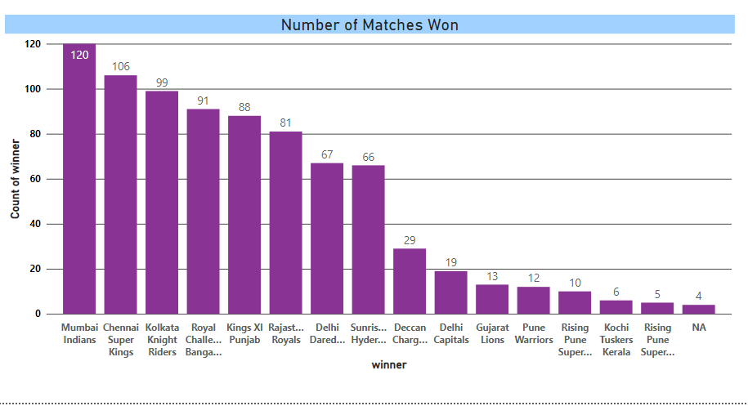
Data Preparation and Consolidation

Slide 11
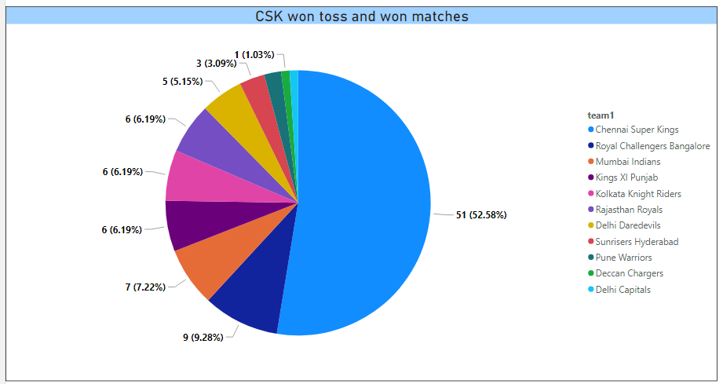
Data Preparation and Consolidation

Slide 12
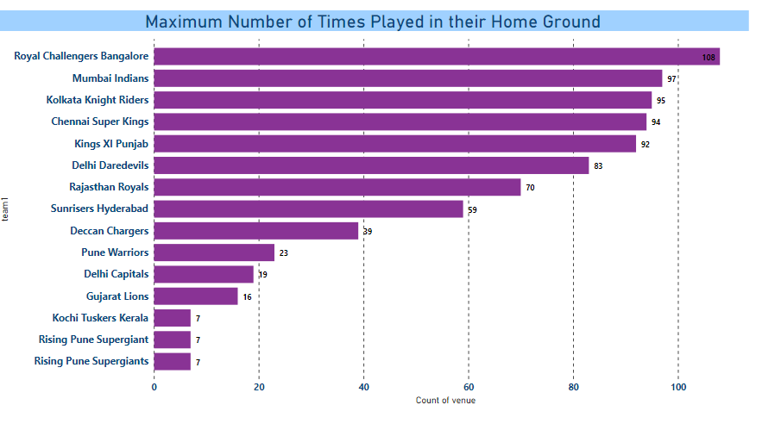
Data Preparation and Consolidation

Slide 13
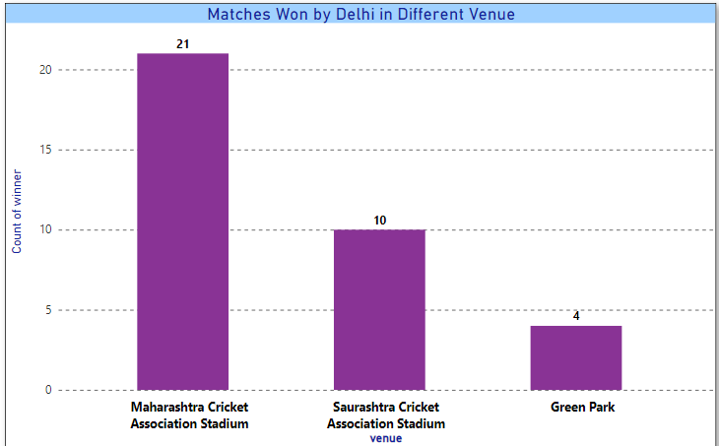
Data Preparation and Consolidation

Slide 14
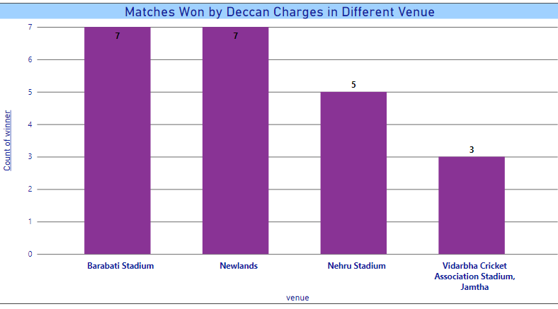
Data Preparation and Consolidation

Slide 15

Data Preparation and Interpretation
After choosing the IPL data we started to do the analysis on Power Bi
At first we filtered the data by matches played in different cities.
Then we filtered how many matches are being played in a year.
Then we filtered the matches played in various stadiums.
Through the matrix function we find out that how many won the toss.
Thereafter also through the matrix function we have created a bar chart of players choosing batting or fielding after winning the toss.
Through the data we got that Mumbai Indians won the match most frequently but as we have analysed after winning the toss only CSK won the match highest number of times.
While playing with Mumbai Indians, CSK won the highest number of times in different places other than their home ground.

Slide 16
Key Challenges
It is a huge data from 2008 to 2020, so analysing it was a very difficult task.
Creating a data-driven culture
Managing the use of self-service BI tools
The data to be displayed like, in how many matches team opted batting first after winning toss and won the match and how many choose fielding and won the match.

Slide 17
Project Plan and Support Required
Results
Conclusion
In between 2008 to 2020 the Mumbai Indian team won the highest number of times among all other teams.
As per the data in Mumbai highest number of matches have been played.
But according to the stadium in Eden garden the highest number of matches has been played.
Finally, as a conclusion we can say that CSK won the matches in their home ground as well as in different places also.
Winning the toss doesn’t decide whether the team will win or lose because as per that data Mumbai Indians won the toss highest number of times but CSK is the one who won the highest number of matches.

Slide 18

Thank You

